Slide 1
How to Analyze text
By Mrs. Opaleski-DiMeo

Slide 2
What is analysis?
Expository writing answers the "who," "what," "where," and "how" questions. It often tends to summarize the text.
Analytical writing, however, focuses on answering “how” and "why" question. When you consider the question, “How did the author accomplish his/her purpose?” and "Why is this point important?", it pushes you beyond mere description into ideas that are convincing, argumentative, and defend a position.
Rather than simply dropping in quotations and expecting their significance and relevance to your argument to be self-evident, you need to provide sufficient analysis of the passage. Remember that your over-riding goal of analysis writing is to demonstrate some new understanding of the text.

Slide 3
Basic format to analysis
Offer a thesis or topic sentence indicating a basic observation or assertion about the text or passage.
Offer a context for the passage without offering too much summary.
Cite the passage (using correct format).
Then follow the passage with some combination of the following elements:
Discuss what happens in the passage and why it is significant to the work as a whole.
Consider what is said, particularly subtleties of the imagery and the ideas expressed.
Assess how it is said, considering how the word choice, the ordering of ideas, sentence structure, etc., contribute to the meaning of the passage.
Explain what it means, tying your analysis of the passage back to the significance of the text as a whole.
Repeat the process of context, quotation and analysis with additional support for your thesis or topic sentence.

Slide 4
How do you analyze a text?
Think carefully about the beginnings and endings of sections of the text, and, too, about the opening and closing of the work as a whole. These privileged positions in the text usually carry important information.
Think carefully about any assertions that the author seems inclined to repeat.
Look closely at any oppositions or conflicts that would seem important in the writer’s treatment of the subject matter.
Try to list any unstated assumptions that might guide the author to think the way he or she does. Can you think of anyone who might not share these assumptions and why?
Why did the author choose to title the piece the way he or she did?

Slide 5
How to Analyze a Text
Always read everything more than once.
Always try to have conversations about the things you read, whether with classmates, friends, or whomever, for all sorts of unexpected insights can emerge in the natural flow of dialogue.
Try to read resistently, to find ways to disagree with or at least to complicate the author’s message.
List as many memorable details in the text and categorize them according to Kenneth Burke’s pentad of “Who-What-When-Where-Why.” And then try to link a detail from one category to a seemingly unrelated detail in another category to evoke a certain resonance between them, the resonance of metaphor. As larger and larger metaphoric relations emerge among more and more details, something like the notorious “hidden meaning” of the text willbe revealed.

Slide 6
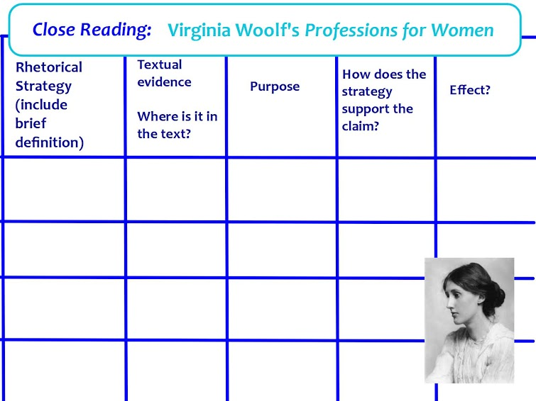
A Graphic Organizer for Analysis

Slide 7
Sample analysis of farewell to arms
If one has read Farewell to Arms, they will see the most common occurrence is in the weather pattern: rain. It seems that every time Hemingway brings up the weather in A Farewell to Arms, it is always raining. Foster brings up a good reason as to why in Chapter 9 of his novel: "Rain can bring the world back to life… Of course, novelists… generally use this function ironically" (Foster 72). A Farewell to Arms begins in the summer, when Frederic is living peacefully in the countryside with the other officers. On the first page of the first chapter, the narrator describes the bed of the river, which is shallow and calm. Protruding rocks, “dry and white in the sun” (3), are unsullied by rain and mud, and maintain their white hue, symbolic of their purity--the river bed has yet to be flooded, and it flows along lazily in the summer sun. The rain, and the war, are far away; the artillery flashes in the distance seem benign, “like summer lightning” (3), rather than an actual threat. The narrator, Frederic, remarks that despite these flashes of the distant violence, “the nights were cool and there was not the feeling of a storm coming” (3). The violence is far-off; Frederic reacts to it just as a child who listens to a storm in bed, but snuggles further under the covers and feels safe. The threat seems not apply to him.

Slide 8
Sample analysis of farewell to arms
As the fighting grows closer and autumn begins to arrive, the land becomes barren and damp: “The vineyards were thin and bare-branched too and all the country was wet and brown and dead with the autumn. There were mists over the river and clouds on the mountain…” (4). The ominous mist and oppressive clouds obscure the summer sun and suck up the heat, depriving the land of life and filling the reader with a sense of foreboding. Then, finally, winter arrives, and at the start of it “came the permanent rain and with the rain came the cholera. But it was checked and in the end only seven # thousand dies of it in the army” (4). The rain is described here are permanent: it is all encompassing, inescapable, and brings with it a disease which effortlessly wipes out vast amounts of soldiers, washing them away as easily as it erodes the dirt. This sentence impresses the reader with a sense of awe—the ease and swiftness with which the rain comes is intimidating. The rain is utterly beyond human control, and the soldiers can do little to protect themselves from its ravages—they are weak and helpless, weighed down by their equipment, totally vulnerable to the awesome power of the indifferent rain.

Slide 9
Sample on james mcbride’s color of water
An important difference between James and his mother is their method of dealing with the pain they experience. While James turns inward, his mother Ruth turns outward, starting a new relationship, moving to a different place, keeping herself busy. Ruth herself describes that, even as a young girl, she had an urge to run, to feel the freedom and the movement of her legs pumping as fast as they can (42). As an adult, Ruth still feels the urge to run. Following her second husband’s death, James points out that, “while she weebled and wobbled and leaned, she did not fall. She responded with speed and motion. She would not stop moving” (163). As she biked, walked, rode the bus all over the city, “she kept moving as if her life depended on it, which in some ways it did. She ran, as she had done most of her life, but this time she was running for her own sanity” (164). Ruth’s motion is a pattern of responding to the tragedy in her life. As a girl, she did not sit and think about her abusive father and her trapped life in the Suffolk store. Instead she just left home, moved on, tried something different. She did not analyze the connections between pain and understanding, between action and response, even though she seems to understand them. As an adult, she continues this pattern, although her running is modified by her responsibilities to her children and home.

Slide 10
Sample on james mcbride’s color of water
The image of running that McBride uses here and elsewhere supports his understanding of his mother as someone who does not stop and consider what is happening in her life yet is able to move ahead. Movement provides the solution, although a temporary one, and preserves her sanity. Discrete moments of action preserve her sense of her own strength and offer her new alternatives for the future. Even McBride’s sentence structure in the paragraph about his mother’s running supports the effectiveness of her spurts of action without reflection. Although varying in length, each of the last seven sentences of the paragraph begins with the subject “She” and an active verb such as “rode,” “walked,” “took,” “grasp” and “ran.” The section is choppy, repetitive and yet clear, as if to reinforce Ruth’s unconscious insistence on movement as a means of coping with the difficulties of her life.

